Slide 1
Process
Process is an instance of executing program
Main function of process is to Execute Instruction residing in main memory
Process is characterized by
Its code, Data, stack and set of register
During its life time, it can be in different states such as running , not running

Slide 2
Reasons for process creation
Is created in response to submission of new job
When a new user attempts to login
Created by OS to provide a service
Spawned by existing process

Slide 3
How a program/job is executed ?
When a new job to be executed :
OS creates data structure for holding the context of process
Loads the job in memory
In multiprogramming environment, many jobs can be in memory
Jobs in memory are ready to execute
At any point of time one Job might be running and others are not executing
Once a running process terminates or its time slice expires or suspended, OS process (Dispatcher ) dispatches ready to execute process for execution

Slide 4
Memory Layout
Program Counter
Dispatcher
Process A
Process C
Process B

Slide 5
Execution Of Ready Processes
D
P1
D
P2
D
P3
D Dispatcher Process
P1, P2, P3 are user processes

Slide 6
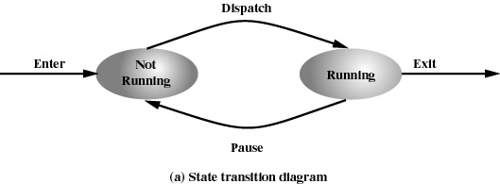
Two State Process Model
Process may in any of the 2 states
Running
Not running

Slide 7
Queuing Diagram
Queue
Exit
Enter
Dispatch
Processor
Pause
Queue May contain ready and blocked processes

Slide 8
State Transition
Not running to running state transition occurs :
process in running state finishes execution
Process makes an I/O request
Time slice of executing process expires
Running to not running state transition occurs :
Running process makes an I/O request
Time slice of executing process expires

Slide 9
Dispatcher
Dispatcher schedules a Ready Process to CPU for its execution.
In Two State model Not Running state contains processes which are :
Ready to run
Blocked
Dispatcher linearly searches the queue to find Ready to run process which increases dispatcher overhead.
Solution : Split not running state into Ready state & Blocked state

Slide 10
Three State Model
Dispatch
Ready
Running
Release
Admit
Time Out
Event Occurs
Event Wait
Blocked

Slide 11
Process States
Running: The process that is currently being executed
Ready: A process that is prepared to execute when given the opportunity
Blocked : A process that can not execute until some events occur
Occurrence of event is usually indicated by interrupt signal

Slide 12
Queuing Diagram
Queue
Exit
Enter
Dispatch
Processor
Pause
Blocked Queue

Slide 13
Queuing Diagram
Queue
Exit
Enter
Dispatch
Processor
Pause
Event 1 Queue
Event n Queue

Slide 14
Five State Model
Dispatch
NEW
Ready
Running
Release
Admit
Exit
Time Out
Event Occurs
Event Wait
Blocked

Slide 15
Why do we need “New” state
Whenever a job is submitted , OS creates data structure for keeping track of the process context and then it tries to load the process. While loading the process
System May not have enough memory to hold the process
If we attempt to load Jobs as they are submitted, there may not be enough resource to execute processes in efficient manner
To efficiently execute processes, system may put a maximum limit on processes in ready queue

Slide 16
Valid State Transitions
New to ready
Ready to running
Running to exit
Running to ready
Running to blocked
Blocked to ready
Ready to exit
Blocked to exit

Slide 17
Consider a scenario
When all ready processes get blocked on I/O one by one, the system tries to bring in a process from new to ready state and it is found no memory is available to accommodate this process
Q. What do we do ?
Ans. Swapping ( What is swapping ?)

Slide 18
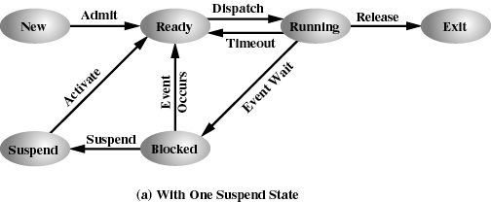
One Suspend State

Slide 19
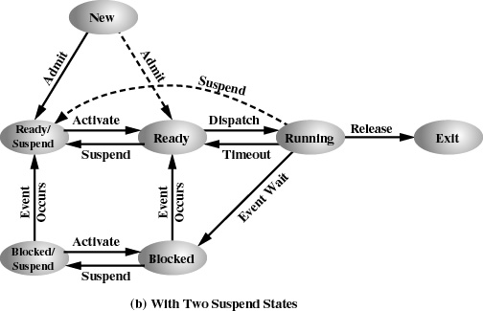
Two Suspend State

Slide 20
State Transitions
Blocked Blocked/suspended:
If Ready queue is empty and insufficient memory is available then one of the blocked process can be swapped out
If currently running process requires more memory
If OS determines that ready process will require more memory

Slide 21
State Transitions
Blocked/ Suspended Ready/suspended
When the event for which process has been waiting occurs
Note
State information concerning to suspended process must be accessible to the OS.
Ready-suspended Ready
If Ready queue is empty
If Process in Ready-suspended state has higher priority than process in Ready state (minimize swapping Vs Service High priority)

Slide 22
State Transitions
Ready Ready/Suspend
Normally a blocked process is suspended
Suspend Ready process if it is the only way to free memory
Suspend a lower priority ready process than higher priority blocked process ?
Blocked Suspended Blocked
Running Ready suspended
Various Exit

Slide 23
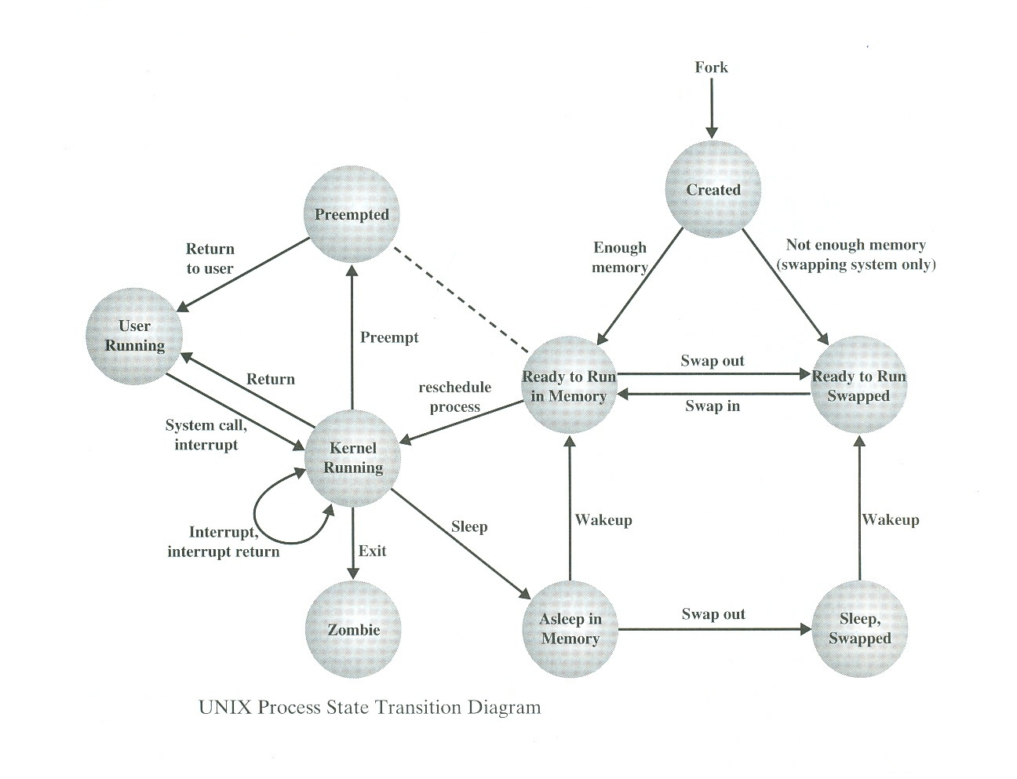
Unix Process State Transition Diagram
8
7
1
3
5
2
9
4
6

Slide 24
Unix Process State Transition
Process is executing in user mode
Process is executing in kernel mode
Process is ready to run as soon as kernel schedules it
Process is sleeping in memory
Process is ready to run but swapper must bring process into main memory
Swapped out to secondary storage
Process is returning from kernel to user mode but kernel preempts it and schedule another process
Newly created process: this state is start state for all processes except process 0
Zombie state is final state of a process

Slide 25
Unix System V
Unix uses two categories of process
System Process : Runs in kernel mode and performs administrative and house keeping functions such as memory allocation, process swapping, scheduling etc.
User Process : Runs in user Mode to execute user program and utilities and in kernel mode to execute instructions belonging to kernel
A user process enters in kernel mode by issuing a system call or when exception/interrupt is generated

Slide 26
Process 0 & Process 1
Process 0 (Swapper Process) is predefined as data structure, loaded at boot time .
Process 0 spawns process 1
Process 1(Init Process) is ancestor of all other processes except process 0

Slide 27
Process Summary
Process is an instance of executing program
In multiprogramming environment number of process can reside in system
At any instance of time processes can be in different state such as ready, Blocked, Running etc. and processes move from one state to another state depending upon certain conditions.
Processes use available system resources
OS is responsible for managing all the processes in the system

Slide 28
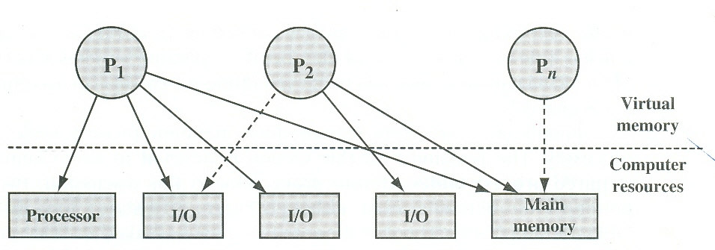
Process & Resource at some instance of time
Process & resource snapshot at some instance of time

Slide 29
OS as Process Manager
OS must have information about the current state of processes
OS must have information about the current state of Resources in the system
OS must keep track of utilization of resources by processes
OS must constructs and maintains tables (control structure) of information about each entity it is managing

Slide 30
OS as Process Manager
To manage processes, OS maintains following tables
Memory Tables
I/O Table
File Table
Process table

Slide 31
Memory Table & I/O Table
Memory Tables keep track
of allocation of main memory to processes
of Allocation of secondary memory to processes
of protection attributes of main & secondary memory such as which processes can access certain shared memory region
Information needed to manage virtual memory
I/O Table
keep track of allocation, availability and request of I/O resources

Slide 32
File Table & Process Table
File Table: Provides information about
Existence of file
Location on secondary memory
Current status and attributes of file
Process table
keep track of processes

Slide 33
Memory Table
Process Image
Memory
I/O Table
Process1
I/O devices
File
File Table
Processes
Process 1
Process 2
Process n
Process 3
Process n
Primary process Table

Slide 34
Process in mamory
Stack
Heap
data
text

Slide 35
Process control structure
Each process is associated with number of attributes .
These attributes are stored in process control block
Collection of data , stack , program and attributes form the process image

Slide 36
Process Image
Process image consists of
User Data
User program
System Stack
Process control block
PCB Contains processes attributes

Slide 37
Process Management
To manage/control a process OS must know
Where process is located
Attributes of processes eg. Process id, state etc
Collection of attributes are held in Process control block

Slide 38
Process Attributes
Process identification
Processor State Information
Processes control information

Slide 39
Process Identification
Identifier of the process
Identifier of the process that created this process
User identifier

Slide 40
Processor State Information
User Visible registers
Control and status registers
Program counter
Flags
Status register
Stack pointer

Slide 41
Processes Control Information
Scheduling and state information
Inter process communication
Process privileges
Memory management
Resource ownership & utilization

Slide 42
Functions of OS kernel
Process Management
Process creation & termination
Process scheduling & dispatching
Process switching
Process synchronization & support for IPC
Management of process control block
Memory Management
Allocation of address space to process
Swapping
Page & segment management

Slide 43
Functions of OS kernel Cont…
I/O Management
Buffer management
Allocation of I/O channels & devices to processes
Support Services
Interrupt handling
Accounting
monitoring

